Slide 1
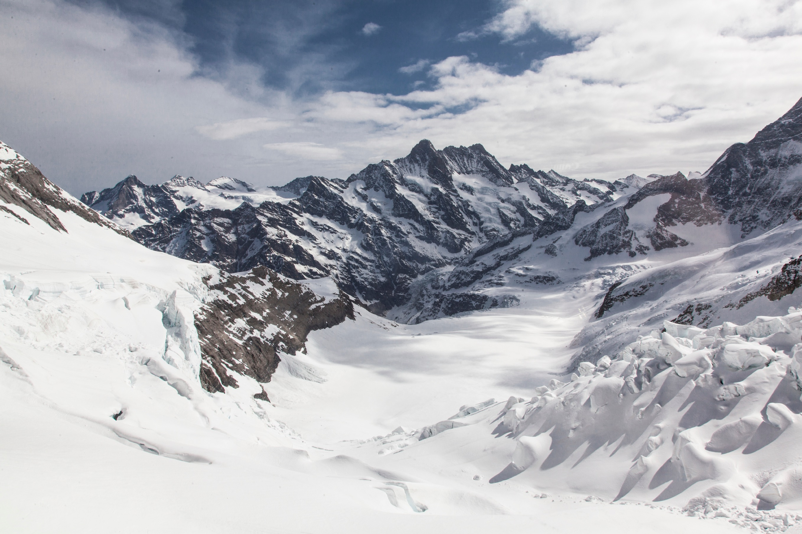

Define your Principles
Notes:
\

Slide 2



